Slide 1
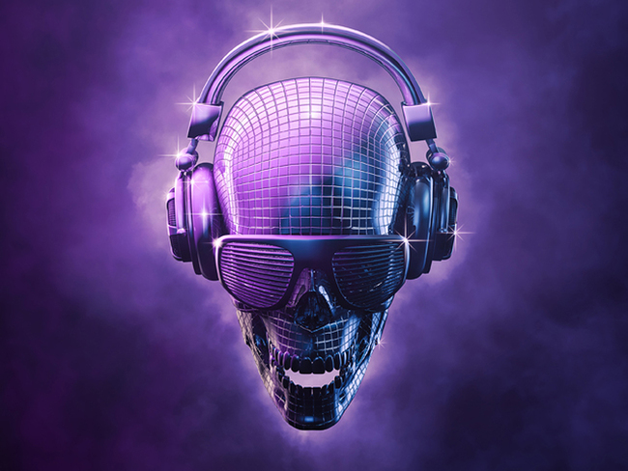

The Exclusive Web 3.0 Live-Streaming Service Platform
Notes:
Cover

Slide 2
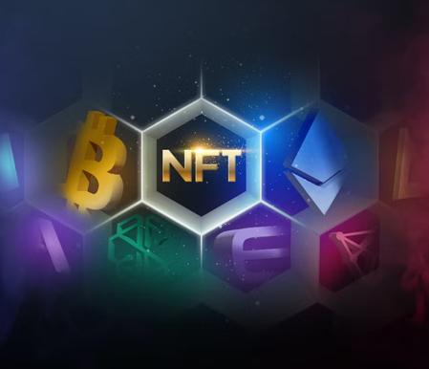
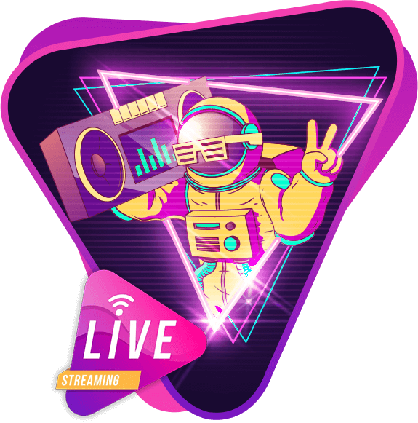

What
We Do
We Do
希望建立一个Web3.0直播平台，平台提供从2D NFT生成3D Avatar NFT的服务，生成的Avatar可以用在直播中。
The project will provide 3D NFT avatar generate technology from 2D PFP NFT by using our AI algorithm, and be able to live streaming with the 3D avatars. Different from previous live broadcasts, The Eden creates the opportunity for the interaction between viewers and anchors in the same space through Metaverse space scenes. GameFi providers and AMA KOLs can open their own DAO to promo their own channel within the platform.
Notes:
Project Intro

Slide 3
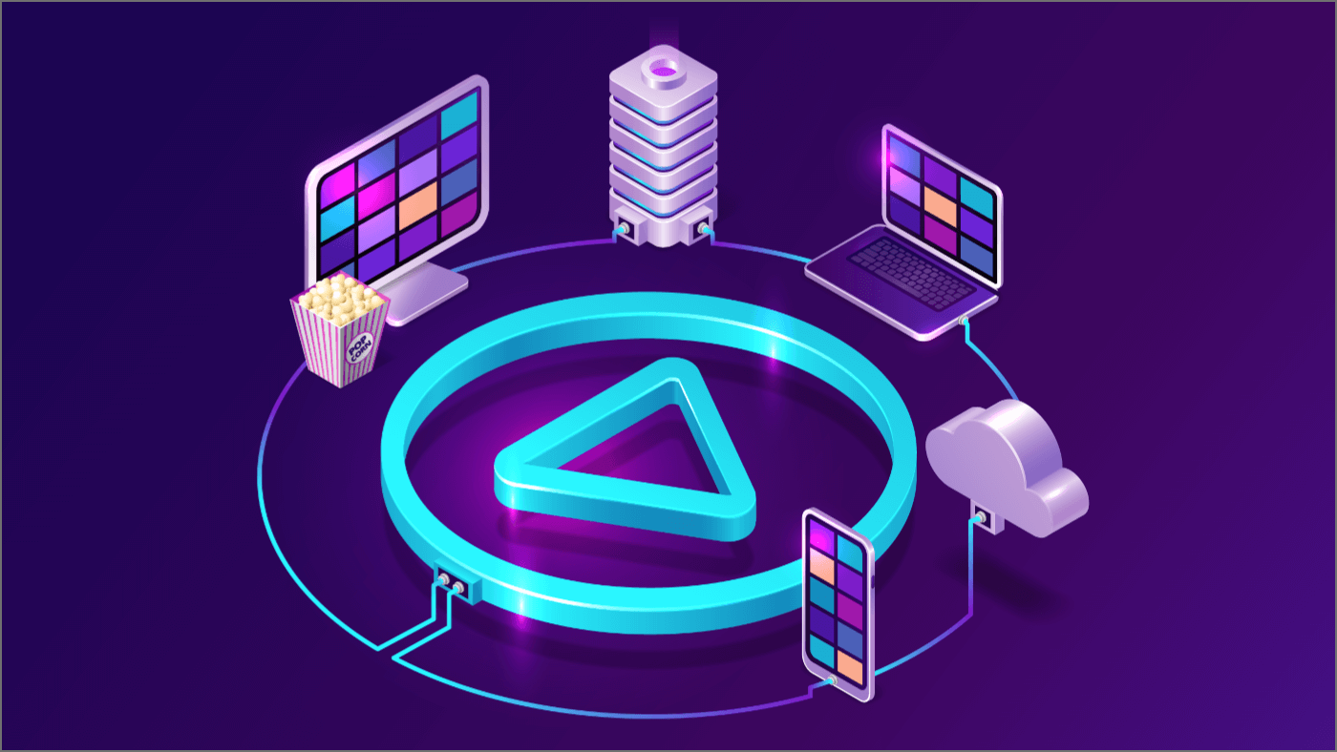







Why
Why
We Do This
We Do This
在Web2.0中，直播已然成为大家日常生活中不可或缺的娱乐方式，但当我们步入Web3.0时代，当前的直播平台已经无法很好地满足Web3.0用户的需求。
在Web3.0的世界中，用户倾向于匿名，3D头套 + DID是一种不错的解决方案。
缺少应用场景是限制NFT发展的原因之一，将NFT用于直播中，不失为推动NFT发展的一次探索。
Notes:
Behind the Story

Slide 4
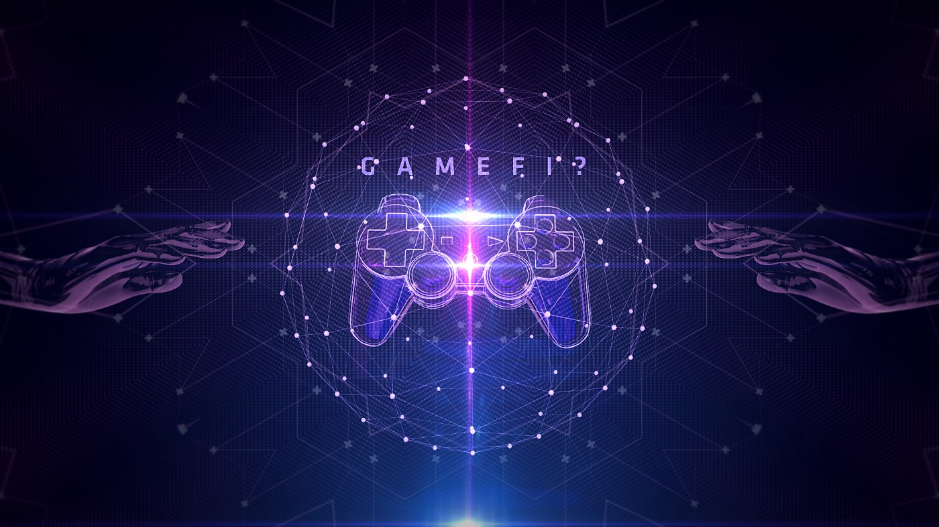





Service
Service
去中心化直播
3D Avatar生成
AR Mask
Notes:
Service

Slide 5
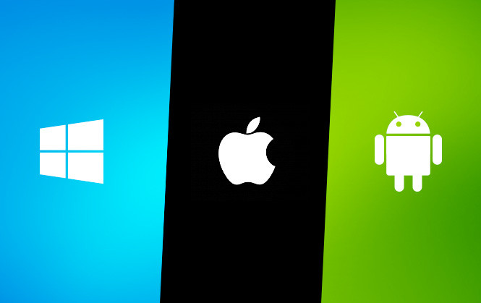
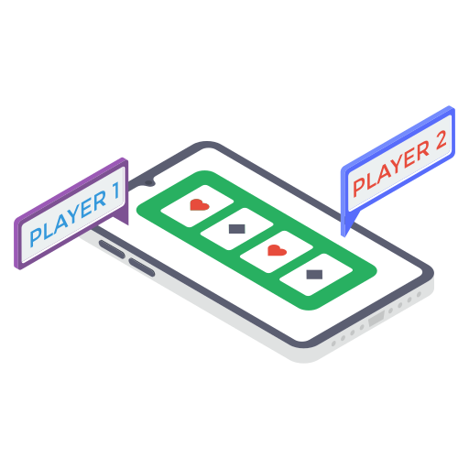






Platform
Platform
Features
Features
Notes:
Platform Features

Slide 6













NFT AI avatar generator
Using VOKA AI technology to build up 3D avatar for live-streaming from 2D NFT.
Platform
Platform
techniques
techniques
Distributed live broadcast
service center
Through the decentralized internal data center to provide live-streaming rendering, storage, video-on-demand
Notes:
Platform Techniques 1

Slide 7



Contact us
Contact us
Dennis HUANG
Telegram: dennishuang85
Email : dennishuang85@icloud.com
VOKATech
Notes:
End

